Slide 1
Programming Fundamental
Week 11
Sobia Iftikhar
Sobia.Iftikhar@nu.edu.pk

Slide 2
Class 22

Slide 3
Example C program to find diameter, circumference and area of circle using function
double getDiameter(double radius);
double getCircumference(double radius);
double getArea(double radius);
int main()
{
float radius, dia, circ, area;
/* Input radius of circle from user */
printf("Enter radius of circle: ");
scanf("%f", &radius);
dia = getDiameter(radius); // Call getDiameter function
circ = getCircumference(radius); // Call getCircumference function
area = getArea(radius); // Call getArea function
printf("Diameter of the circle = %.2f units\n", dia);
printf("Circumference of the circle = %.2f units\n", circ);
printf("Area of the circle = %.2f sq. units", area);
return 0;
}
double getDiameter(double radius)
{
return (2 * radius);
}
double getCircumference(double radius)
{
return (2 * M_PI * radius); // M_PI = PI = 3.14 ...
}
double getArea(double radius)
{
return (M_PI * radius * radius); // M_PI = PI = 3.14 ...
}

Slide 4
Program to find maximum and minimum between two numbers using functions
#include <stdio.h>
int max(int num1, int num2);
int min(int num1, int num2);
int main()
{
int num1, num2, maximum, minimum;
printf("Enter any two numbers: ");
scanf("%d%d", &num1, &num2);
maximum = max(num1, num2); // Call maximum function
minimum = min(num1, num2); // Call minimum function
printf("\nMaximum = %d\n", maximum);
printf("Minimum = %d", minimum);
return 0;
}
int max(int num1, int num2)
{
return (num1 > num2 ) ? num1 : num2;
}
int min(int num1, int num2)
{
return (num1 > num2 ) ? num2 : num1;
}

Slide 5
Recursion
When a function invokes itself, the call is known as a recursive call. Recursion (the ability of a function to call itself) is an alternative control structure to repetition (looping). Rather than use a looping statement to execute a program segment, the program uses a selection statement to determine whether to repeat the code by calling the function again or to stop the process.

Slide 6
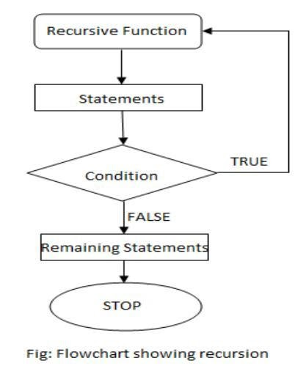
Recursion

Slide 7
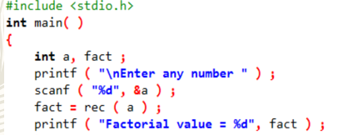
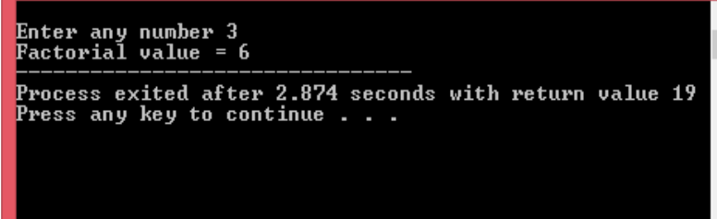
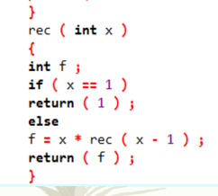
Example

Slide 8
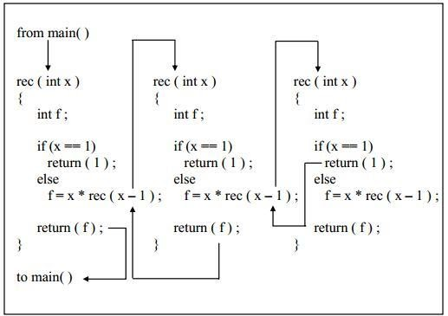
Description

Slide 9
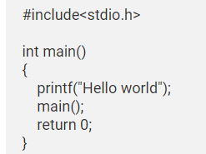
Example #1: C Program to show infinite recursive function

Slide 10
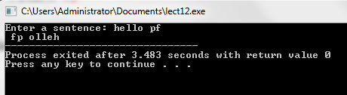
Example
Reverse a sentence using recursion
#include <stdio.h>
void reverseSentence();
int main() {
printf("Enter a sentence: ");
reverseSentence();
return 0;
}
void reverseSentence() {
char c;
scanf("%c", &c);
if (c != '\n') {
reverseSentence();
printf("%c", c);
}
}

Slide 11
Examples
#include <stdio.h>
int sumOfEvenOdd(int start, int end);
int main()
{
int start, end, sum;
/* Input lower and upper limit from user */
printf("Enter lower limit: ");
scanf("%d", &start);
printf("Enter upper limit: ");
scanf("%d", &end);
printf("Sum of even/odd numbers between %d to %d = %d\n", start, end, sumOfEvenOdd(start, end));
return 0;
}
int sumOfEvenOdd(int start, int end)
{
/* Base condition */
if(start > end)
return 0;
else
return (start + sumOfEvenOdd(start + 2, end));
}
Program to find sum of even or odd numbers using recursion

Slide 12
Structure
In C programming, a struct (or structure) is a collection of variables (can be of different types) under a single name.
Arrays allow to define type of variables that can hold several data items of the same kind. Similarly structure is another user defined data type available in C that allows to combine data items of different kinds.
Structures are used to represent a record

Slide 13
Syntax of struct
struct structureName {
dataType member1;
dataType member2;
...
};
struct Person {
char name[50];
int citNo;
float salary;
};

Slide 14
Create struct Variables
When a struct type is declared, no storage or memory is allocated. To allocate memory of a given structure type and work with it, we need to create variables.
Here's how we create structure variables:
Another way of creating a struct variable is:
struct Person {
// code
};
int main() {
struct Person person1, person2, p[20];
return 0;
}
struct Person {
// code
} person1, person2, p[20];

Slide 15
Access Members of a Structure
There are two types of operators used for accessing members of a structure.
. - Member operator
-> - Structure pointer operator

Slide 16

Example
#include <stdio.h>
#include <string.h>
// create struct with person1 variable
struct Person {
char name[50];
int citNo;
float salary;
} person1;
int main() {
// assign value to name of person1
strcpy(person1.name, "George Orwell");
// assign values to other person1 variables
person1.citNo = 1984;
person1. salary = 2500;
// print struct variables
printf("Name: %s\n", person1.name);
printf("Citizenship No.: %d\n", person1.citNo);
printf("Salary: %.2f", person1.salary);
return 0;
}

Slide 17
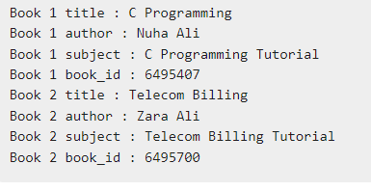
Example Suppose you want to keep track of your books in a library. You might want to track the following attributes about each book.
Title
Author
Subject
Book ID
Output expected

Slide 18
Solution
#include <stdio.h>
#include <string.h>
struct Books {
char title[50];
char author[50];
char subject[100];
int book_id;
};
int main( ) {
struct Books Book1; /* Declare Book1 of type Book */
struct Books Book2; /* Declare Book2 of type Book */
/* book 1 specification */
strcpy( Book1.title, "C Programming");
strcpy( Book1.author, "Nuha Ali");
strcpy( Book1.subject, "C Programming Tutorial");
Book1.book_id = 6495407;
/* book 2 specification */
strcpy( Book2.title, "Telecom Billing");
strcpy( Book2.author, "Zara Ali");
strcpy( Book2.subject, "Telecom Billing Tutorial");
Book2.book_id = 6495700;
/* print Book1 info */
printf( "Book 1 title : %s\n", Book1.title);
printf( "Book 1 author : %s\n", Book1.author);
printf( "Book 1 subject : %s\n", Book1.subject);
printf( "Book 1 book_id : %d\n", Book1.book_id);
/* print Book2 info */
printf( "Book 2 title : %s\n", Book2.title);
printf( "Book 2 author : %s\n", Book2.author);
printf( "Book 2 subject : %s\n", Book2.subject);
printf( "Book 2 book_id : %d\n", Book2.book_id);
return 0;
}

Slide 19
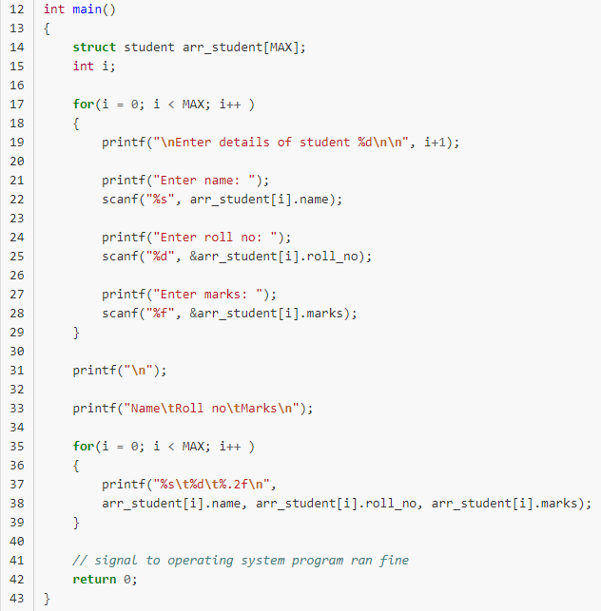
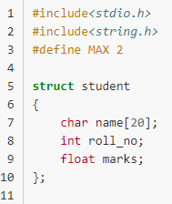
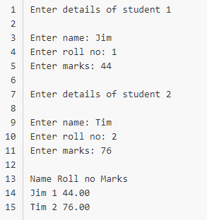
Array of structure in c

Slide 20
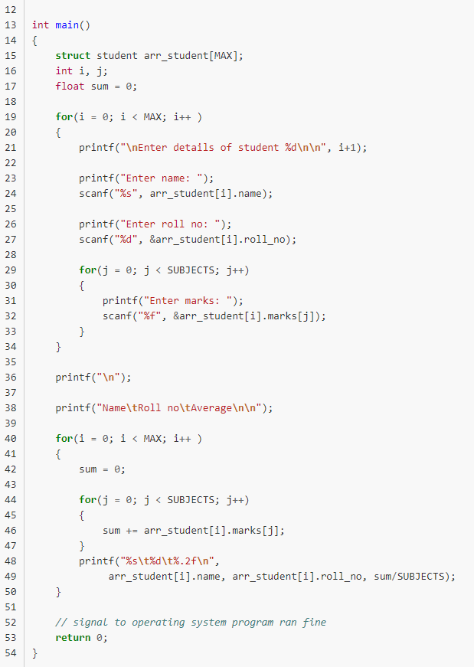
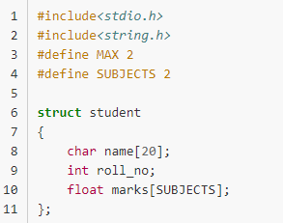
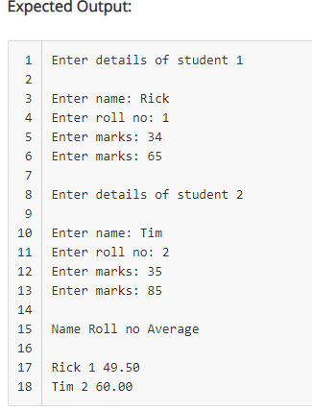
Array as Member of Structure in C

Slide 21
Thankyou

